Slide 1
Max Flow in a network
4
2
5
3
1
1
1
2
2
s
4
t
3
2
1
3
Find maximum flow from source “S” to destination “t”
Capacity of each pipe line is shown

Slide 2
A flow in a network is an assignment of non negative nos f _{ij} to every edge (i,j) such that the following conditions are satisfied:
for every edge (i,j) of G
f _{ij} ≤ c _{ij}
Σf _{si} - Σ f _{is} = w
Where the summation is taken over all vertices in G,Quantity w is called the value of the flow.
for the sink
Σf _{ti} - Σ f _{it} = - w
for all other vertices j
Σf _{ji} - Σ f _{ij} = 0

Slide 3
Through any edge (i,j) at most C _{ij} units of flow may pass.
At any vertex v that is neither source or sink, total flow coming into must be equal to total flow going out.
A vertex can combine and distribute flow in any manner that it likes, as long as edge capacities are not violated and as long as flow conservation is maintained.

Slide 5
Vertex a has 3 units coming in,which it distributes to c and d.
Original graph
Flow graph
S
S
3
2
3
2
a
1
a
0
b
b
4
2
1
2
3
2
c
c
d
d
2
2
3
3
T
T
Vertex d takes three units from a and b and sends combined to t

Slide 6
A Graph & Its Max Flow
S
S
3
2
3
2
a
1
a
0
b
b
4
2
1
2
3
2
c
c
d
d
2
2
3
3
T
T

Slide 7
Initial Stages of Graph,Flow graph and Residual graph
Original graph
Flow graph
Residual graph
S
S
S
3
2
0
0
3
2
a
1
b
a
0
b
a
1
b
3
4
2
0
0
0
3
4
2
c
d
c
d
c
d
2
3
0
0
2
3
T
T
T

Slide 8
G,G(f),G(r) after two units of flow added along s,b,d,t
Original graph
Flow graph
Residual graph
S
S
S
3
2
0
2
3
a
1
b
a
0
b
a
1
b
3
4
2
0
0
2
3
4
c
d
c
d
c
d
2
3
0
2
2
1
T
T
T

Slide 9
G,G(f),G(r) after two units of flow added along s,a,c,t
Flow graph
Residual graph
Original graph
S
S
S
3
2
2
2
1
a
1
b
a
0
b
a
1
b
3
4
2
2
0
2
1
4
c
d
c
d
c
d
2
3
2
2
1
T
T
T

Slide 10
G,G(f),G(r) after one unit of flow
added along s,a,d,t-algorithm terminates
Flow graph
Residual graph
Original graph
S
S
S
3
2
3
2
a
1
b
a
0
b
a
1
b
3
4
2
2
1
2
1
3
c
d
c
d
c
d
2
3
2
3
T
T
T
This is optimal flow.This value is a minimum cut also for the pair s and t.

Slide 11
Greedy approach fails
Flow graph
Residual graph
Original graph
S
S
S
3
2
3
0
2
a
1
b
a
0
b
a
1
b
3
4
2
0
3
0
3
1
2
c
d
c
d
c
d
2
3
0
3
2
T
T
T
Suppose initially we select s , a, d, t path to send.Result is that there is no longer any path from s to t now.thus failed to get optimum flow.Thus greedy approach fails here also.

Slide 12
In order to make this algorithm work we need to allow the algorithm to change its mind.
To do this for every edge(v,w) with flow f_{vw} in the flow graph, we will add an edge in the residual graph(w,v) of capacity f _{vw.}
This is to undo its earlier decision by sending flow back in the opposite direction.

Slide 13
Graphs after three units of flow
added along s,a,d,t using correct algorithm
Flow graph
Residual graph
Original graph
S
S
S
3
2
3
0
3
2
a
1
b
a
0
b
a
1
b
3
4
2
0
3
0
3
2
3
c
d
c
d
c
1
d
2
3
0
3
2
3
T
T
T
In the residual graph there are edges in both directions between a and d.Either one more unit may be sent from a to d or upto three units can be pushed back-we can undo flow. Augmenting path now is s,b,d,a,c,t of flow 2.

Slide 14
By pushing two units of flow from d to a,
the algorithm takes two units of flow away from the edge(a,d)
and is essentially changing its mind.

Slide 15
Graphs after two units of flow
added along s,b,d,a,c,t using correct algorithm
Flow graph
Residual graph
Original graph
S
S
S
3
2
3
2
3
2
a
1
b
a
0
b
a
1
b
3
4
2
2
1
2
2
1
1
2
c
d
c
d
c
3
d
2
3
2
3
2
3
T
T
T
Maximum flow is 5 units from s to t

Slide 16
Ford-Fulkerson Max- Flow Algorithm
4
2
5
3
1
1
1
2
2
s
4
t
3
2
1
Green colored edges have zero capacity
3
This is the original network, plus reversals of the arcs.

Slide 17
Ford-Fulkerson Max Flow
4
2
5
3
1
1
1
2
2
s
4
t
3
2
1
3
Find any s-t path in G(x) of positive weight.
Weight of the path is the min capacity of any edge of the path
Weight of this path is one

Slide 18
Ford-Fulkerson Max Flow
Path used was S-3-4-t of capacity = 1
4
2
5
3
1
1
1
2
1
2
Ford-Fulkerson Max Flow
s
4
t
2
1
3
2
1
4
1
2
5
1
3
3
1
1
1
Determine the capacity Δ of the path.
2
2
s
4
t
3
2
Send Δ units of flow in the path.
Update residual capacities.
1
Green colored edges have zero capacity
3
This is the original network, plus reversals of the arcs.

Slide 19
Ford-Fulkerson Max Flow
4
2
5
3
1
1
1
2
1
2
s
4
t
2
1
3
2
1
1
1
3
Find any s-t path of positive weight/capacity

Slide 20
Ford-Fulkerson Max Flow
4
2
5
3
1
1
1
2
1
1
1
s
4
t
2
1
1
3
2
2
1
1
1
1
3
1
Determine the capacity Δ of the path.
Send Δ units of flow in the path.
Update residual capacities.

Slide 21
Ford-Fulkerson Max Flow
4
2
5
3
1
1
1
2
1
1
1
s
4
t
2
1
1
3
2
2
1
1
1
1
3
1
Find any s-t path of positive weight /capacity

Slide 22
Ford-Fulkerson Max Flow
4
2
5
3
1
1
1
1
1
1
s
4
t
1
2
1
2
2
3
1
1
1
1
3
1
Determine the capacity Δ of the path.
Send Δ units of flow in the path.
Update residual capacities.

Slide 23
Ford-Fulkerson Max Flow
4
2
5
3
1
1
1
1
2
1
1
s
4
t
1
2
1
2
2
3
1
1
1
1
3
1
Find any s-t path of positive weight//capacity

Slide 24
Ford-Fulkerson Max Flow
4
2
5
3
1
1
1
1
2
1
1
s
4
t
1
2
1
1
2
2
1
1
1
2
1
2
3
1
Determine the capacity Δ of the path.
Send Δ units of flow in the path.
Update residual capacities.

Slide 25
Ford-Fulkerson Max Flow
4
2
5
3
1
1
1
1
2
1
1
s
4
t
1
2
1
1
2
2
1
1
2
1
2
3
1
Find any s-t path

Slide 26
Ford-Fulkerson Max Flow
4
3
2
5
1
3
1
2
1
1
1
1
s
4
t
1
2
1
1
2
2
1
1
2
1
2
3
1
Determine the capacity Δ of the path.
Send Δ units of flow in the path.
Update residual capacities.

Slide 27
Ford-Fulkerson Max Flow
4
3
2
5
1
3
1
2
1
1
1
1
s
4
t
1
2
1
1
2
2
1
1
2
1
2
3
1
There is no s-t path in the residual network. This flow is optimal

Slide 28
Ford-Fulkerson Max Flow
4
3
2
2
5
5
1
3
1
2
1
1
1
1
s
s
4
4
t
1
2
1
1
2
2
1
1
2
1
2
3
1
3
These are the nodes that are reachable from node s.
Hence it is a maximum flow

Slide 29
Ford-Fulkerson Max Flow
1
2
5
1
1
2
2
s
4
t
2
2
3
Here is the optimal flow

Slide 30
If the capacities are all integers and the maximum flow is f, then since each augmenting path increases the flow by at least 1, f stages suffice, and the total running time is O( f . |E|)
Since an augmenting path can be found in O(|E|) time.

Slide 31
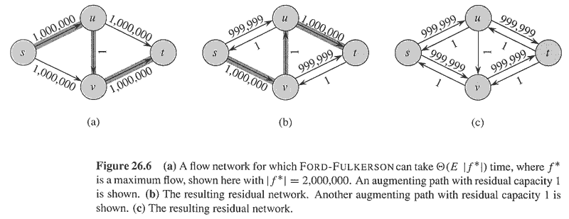
Copyright © The McGraw-Hill Companies, Inc. Permission required for reproduction or display.

Slide 32
Cuts of Flows networks
Def: A cut (S , T) of flow network G = (V,E) is a partition of V into two sets:
S and T = V-S
such that
Source s is in S
And
sink t is in T
If f is a flow then the net flow across the cut (S, T) is defined to be f(S,T).
The capacity of the cut (S,T) is denoted as C(S,T).
The capacity of C(S,T) is defined o be sum of the capacities of those edges directed from the vertices in the set S to the vertices in T.
Minimum cut of a network is a cut whose capacity is minimum over all cuts of the network.

Slide 33
12/12
12/12
v1
v3
15/20
11/16
1/4
t
S
10
7/7
4/9
8/13
v2
v4
4/4
11/14

Slide 34
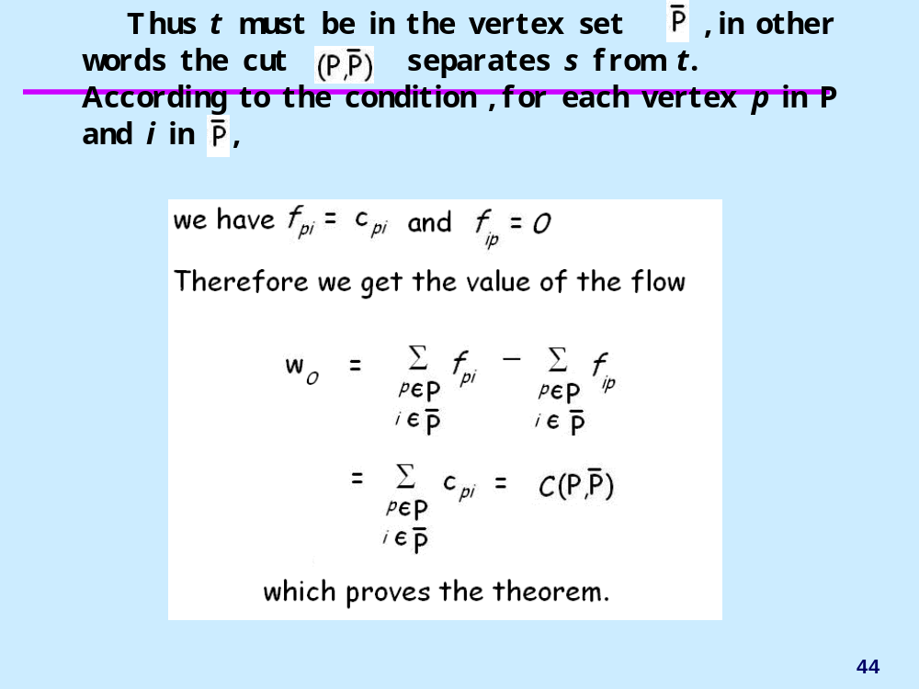
Flow w0 for a cut (P, P-) is defined as:

Slide 35
{s,v1,v2}, {v3,v4,t} is a cut
Net flow across the cut is
F(v1,v3) + f(v2 , v3) + f(v2 , v4) = 12 +(-4) +11=19
Capacity of his cut is
C(v1, v3) +c(v2,v4) = 12 +14=26

Slide 36
Let us consider all the cuts (2⁴ ) cuts
Also find their capacities.
the minimum cut has capacity 5
S ={s,2,3,4,5 }
T= {t}
Let S= {s,3}
T= S complement
C(S,T)= 8
4
2
5
3
1
1
1
2
2
s
4
t
3
2
1
Green colored edges have zero capacity
3
This is the original network, plus reversals of the arcs.

Slide 37
Max flow min cut theorem
If f is a flow in a flow network G(V,E) with source and sink s and t, then the following conditions are equivalent:
F is a maximum flow in G
The residual graph G contains no augmenting path
|f| = c(S, T) for some cut (S,T) of G

Slide 38

Theorem 1
Theorem:
In a given transport network G, the value of flow w from source s to sink t is less than or equal to the capacity of any cut separating s from t.
Proof:
let be an arbitrary cut such that the source s in vertex set P and the sink t in vertex set .
Now let us write eq for all vertices in P and add them.

Slide 39
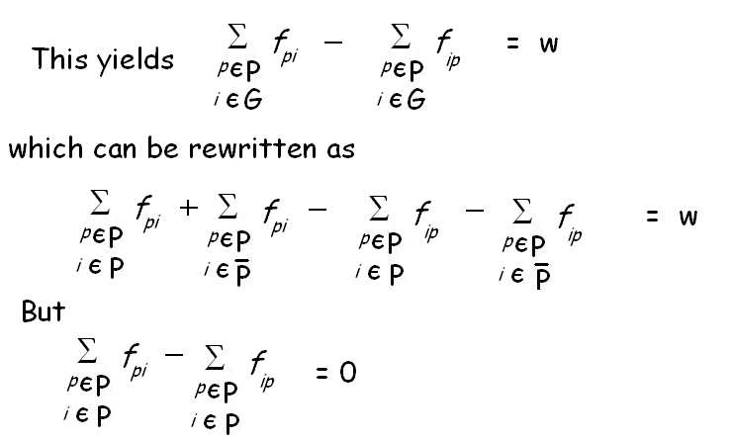

Slide 40
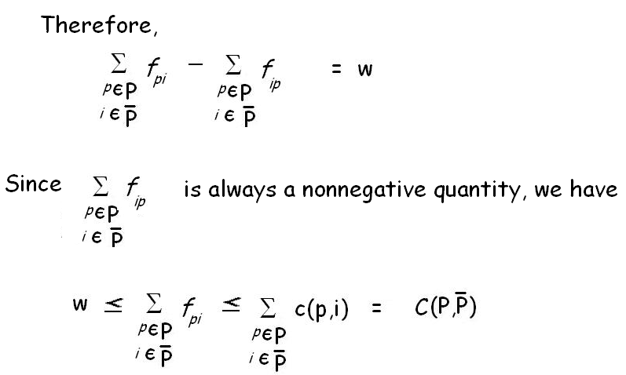


Slide 41
Max-Flow Min-Cut Theorem
Theorem:
In a given transport network G, the maximum value of a flow from s to t is equal to the minimum value of the capacities of all the cuts in G that separate s from t.
Proof:
Let there be some flow pattern in G such that the value of flow from s to t is at its maximum possible value w_{o}.

Slide 42
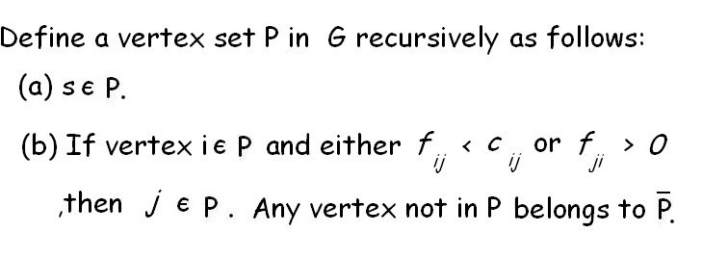
Now vertex t cannot be in P. If it were, there would be a path p from s to t, say s,v₁,v₂….,v_{j},v_{j+1},….v_{k},t, for which in every edge either flow f_{v,vj+1}, < c_{v},_{vj+1}, or f_{vj+1},_{vj} > 0.
In path p an edge (v_{j},v_{j+1}) directed from v_{j} to v_{j+1} is called a forward edge
and an edge (v_{j+1},v_{j})directed from v_{j+1} to v_{j} is called a backward edge.

Slide 43
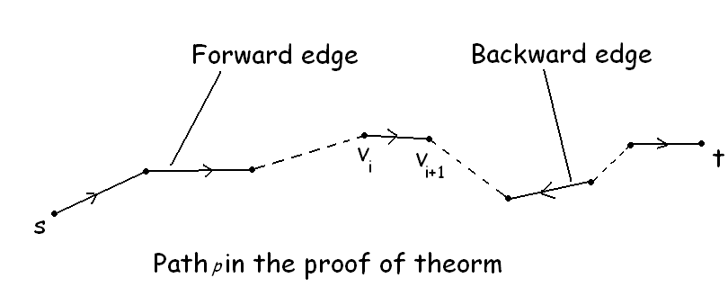

Slide 44




In path p let be the minimum of all differences
[c_{v,vj+1} - f_{vj,vj+1}] in forward edges.
Similarly in backward edges.
Now the flow in the network G can be increased by increasing the flow in each forward edge and decreasing the flow in each backward edge by an amount .
This contradicts the assumption that w_{o} was maximum flow.

Slide 45

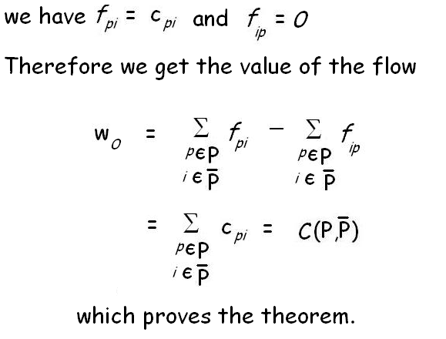
Thus t must be in the vertex set ,in other words the cut separates s from t. According to the condition ,for each vertex p in P and i in ,

